Slide 1


Chapter 8
NP and Computational
Intractability
Slides by Kevin Wayne.
Copyright © 2005 Pearson-Addison Wesley.
All rights reserved.

Slide 2
8.5 Sequencing Problems
Basic genres.
  Packing problems: SET-PACKING, INDEPENDENT SET.
  Covering problems: SET-COVER, VERTEX-COVER.
  Constraint satisfaction problems: SAT, 3-SAT.
  Sequencing problems: HAMILTONIAN-CYCLE, TSP.
  Partitioning problems: 3D-MATCHING, 3-COLOR.
  Numerical problems: SUBSET-SUM, KNAPSACK.

Slide 3
Hamiltonian Cycle
HAM-CYCLE: given an undirected graph G = (V, E), does there exist a simple cycle Γ that contains every node in V.
YES: vertices and faces of a dodecahedron.

Slide 4
Hamiltonian Cycle
HAM-CYCLE: given an undirected graph G = (V, E), does there exist a simple cycle Γ that contains every node in V.
1
1'
2
2'
3
3'
4
4'
5
NO: bipartite graph with odd number of nodes.

Slide 5
Directed Hamiltonian Cycle
DIR-HAM-CYCLE: given a digraph G = (V, E), does there exists a simple directed cycle Γ that contains every node in V?
Claim. DIR-HAM-CYCLE ≤ _{P} HAM-CYCLE.
Pf. Given a directed graph G = (V, E), construct an undirected graph G' with 3n nodes.
a_{out}
a
d_{in}
d
b
v
b_{out}
v_{in}
v
v_{out}
e
c
e_{in}
c_{out}
G
G'

Slide 6
Directed Hamiltonian Cycle
Claim. G has a Hamiltonian cycle iff G' does.
Pf. ⇒
  Suppose G has a directed Hamiltonian cycle Γ.
  Then G' has an undirected Hamiltonian cycle (same order).
Pf. ⇐
  Suppose G' has an undirected Hamiltonian cycle Γ'.
  Γ' must visit nodes in G' using one of following two orders:
    …, B, G, R, B, G, R, B, G, R, B, …
    …, B, R, G, B, R, G, B, R, G, B, …
  Blue nodes in Γ' make up directed Hamiltonian cycle Γ in G, or reverse of one. ▪

Slide 7
3-SAT Reduces to Directed Hamiltonian Cycle
Claim. 3-SAT ≤ _{P} DIR-HAM-CYCLE.
Pf. Given an instance Φ of 3-SAT, we construct an instance of DIR-HAM-CYCLE that has a Hamiltonian cycle iff Φ is satisfiable.
Construction. First, create graph that has 2^{n} Hamiltonian cycles which correspond in a natural way to 2^{n} possible truth assignments.

Slide 8
3-SAT Reduces to Directed Hamiltonian Cycle
Construction. Given 3-SAT instance Φ with n variables x_{i} and k clauses.
  Construct G to have 2^{n} Hamiltonian cycles.
  Intuition: traverse path i from left to right ⇔ set variable x_{i} = 1.
s
x₁
x₂
x₃
t
3k + 3
Notes:
the bi-directed edge represents two anti-parallel directed edges

Slide 9


3-SAT Reduces to Directed Hamiltonian Cycle
Construction. Given 3-SAT instance Φ with n variables x_{i} and k clauses.
  For each clause: add a node and 6 edges.
clause node
clause node
s
x₁
x₂
x₃
t

Slide 10
3-SAT Reduces to Directed Hamiltonian Cycle
Claim. Φ is satisfiable iff G has a Hamiltonian cycle.
Pf. ⇒
  Suppose 3-SAT instance has satisfying assignment x*.
  Then, define Hamiltonian cycle in G as follows:
    if x*_{i} = 1, traverse row i from left to right
    if x*_{i} = 0, traverse row i from right to left
    for each clause C_{j} , there will be at least one row i in which we are going in "correct" direction to splice node C_{j} into tour

Slide 11
3-SAT Reduces to Directed Hamiltonian Cycle
Claim. Φ is satisfiable iff G has a Hamiltonian cycle.
Pf. ⇐
  Suppose G has a Hamiltonian cycle Γ.
  If Γ enters clause node C_{j} , it must depart on mate edge.
    thus, nodes immediately before and after C_{j} are connected by an edge e in G
    removing C_{j} from cycle, and replacing it with edge e yields Hamiltonian cycle on G - { C_{j} }
  Continuing in this way, we are left with Hamiltonian cycle Γ' in
  G - { C₁ , C₂ , . . . , C_{k} }.
  Set x*_{i} = 1 iff Γ' traverses row i left to right.
  Since Γ visits each clause node C_{j} , at least one of the paths is traversed in "correct" direction, and each clause is satisfied. ▪

Slide 12
Longest Path
SHORTEST-PATH. Given a digraph G = (V, E), does there exists a simple path of length at most k edges?
LONGEST-PATH. Given a digraph G = (V, E), does there exists a simple path of length at least k edges?
Claim. 3-SAT ≤ _{P} LONGEST-PATH.
Pf 1. Redo proof for DIR-HAM-CYCLE, ignoring back-edge from t to s.
Pf 2. Show HAM-CYCLE ≤ _{P} LONGEST-PATH.

Slide 13

The Longest Path ^{t}
Lyrics. Copyright © 1988 by Daniel J. Barrett.
Music. Sung to the tune of The Longest Time by Billy Joel.
Woh-oh-oh-oh, find the longest path!
Woh-oh-oh-oh, find the longest path!
If you said P is NP tonight,
There would still be papers left to write,
I have a weakness,
I'm addicted to completeness,
And I keep searching for the longest path.
The algorithm I would like to see
Is of polynomial degree,
But it's elusive:
Nobody has found conclusive
Evidence that we can find a longest path.
I have been hard working for so long.
I swear it's right, and he marks it wrong.
Some how I'll feel sorry when it's done:
GPA 2.1
Is more than I hope for.
Garey, Johnson, Karp and other men (and women)
Tried to make it order N log N.
Am I a mad fool
If I spend my life in grad school,
Forever following the longest path?
Woh-oh-oh-oh, find the longest path!
Woh-oh-oh-oh, find the longest path!
Woh-oh-oh-oh, find the longest path.
t Recorded by Dan Barrett while a grad student at Johns Hopkins during a difficult algorithms final.
Notes:
http://www.cs.princeton.edu/~wayne/cs423/lectures/longest-path.mp3

Slide 14
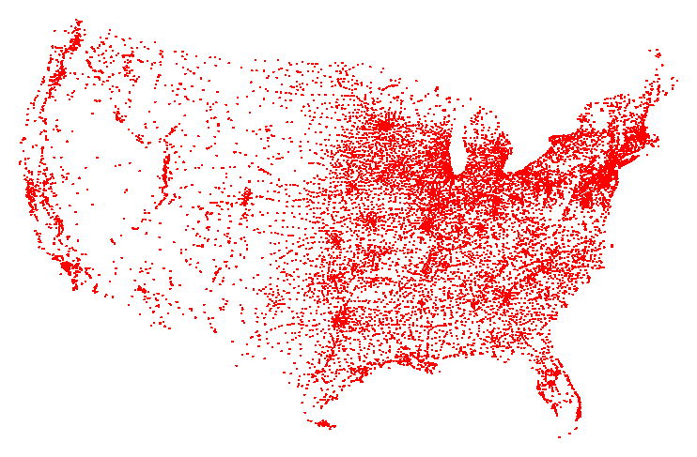
Traveling Salesperson Problem
TSP. Given a set of n cities and a pairwise distance function d(u, v), is there a tour of length ≤ D?
All 13,509 cities in US with a population of at least 500
Reference: http://www.tsp.gatech.edu

Slide 15
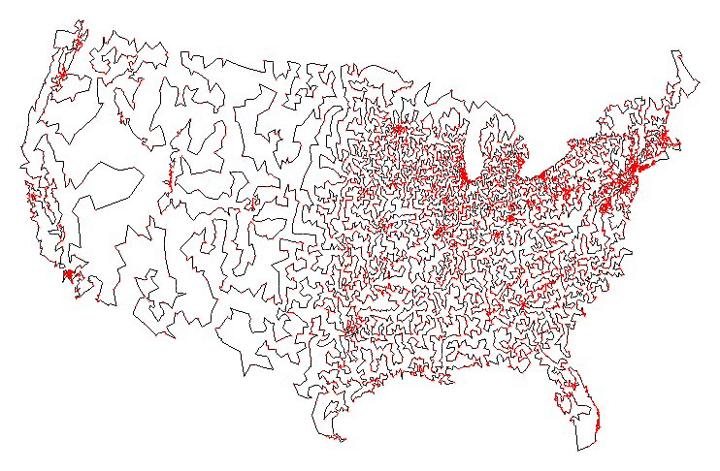
Traveling Salesperson Problem
TSP. Given a set of n cities and a pairwise distance function d(u, v), is there a tour of length ≤ D?
Optimal TSP tour
Reference: http://www.tsp.gatech.edu

Slide 16
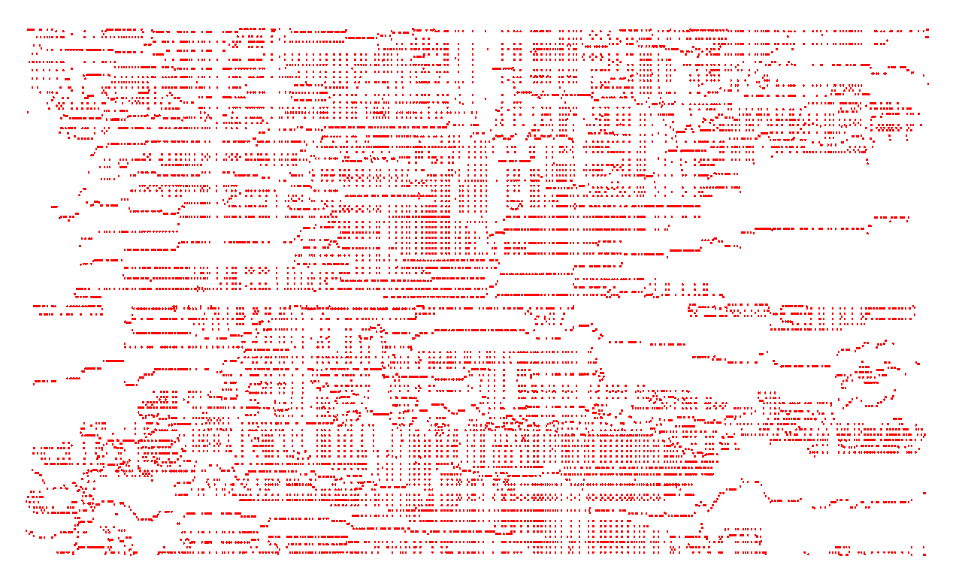
Traveling Salesperson Problem
TSP. Given a set of n cities and a pairwise distance function d(u, v), is there a tour of length ≤ D?
11,849 holes to drill in a programmed logic array
Reference: http://www.tsp.gatech.edu

Slide 17
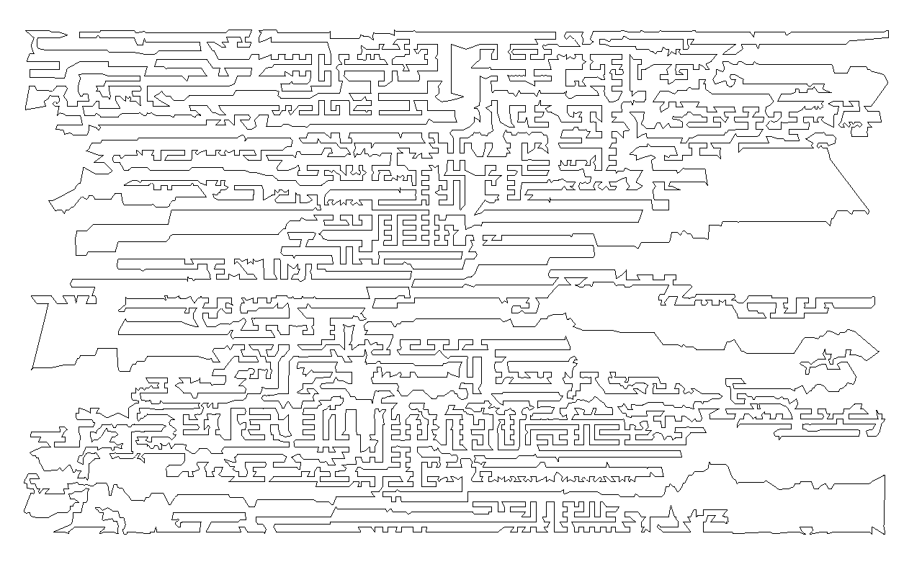
Traveling Salesperson Problem
TSP. Given a set of n cities and a pairwise distance function d(u, v), is there a tour of length ≤ D?
Optimal TSP tour
Reference: http://www.tsp.gatech.edu

Slide 18
Traveling Salesperson Problem
TSP. Given a set of n cities and a pairwise distance function d(u, v), is there a tour of length ≤ D?
HAM-CYCLE: given a graph G = (V, E), does there exists a simple cycle that contains every node in V?
Claim. HAM-CYCLE ≤ _{P} TSP.
Pf.
  Given instance G = (V, E) of HAM-CYCLE, create n cities with distance function
  TSP instance has tour of length ≤ n iff G is Hamiltonian. ▪
Remark. TSP instance in reduction satisfies Δ-inequality.

Slide 19
8.6 Partitioning Problems
Basic genres.
  Packing problems: SET-PACKING, INDEPENDENT SET.
  Covering problems: SET-COVER, VERTEX-COVER.
  Constraint satisfaction problems: SAT, 3-SAT.
  Sequencing problems: HAMILTONIAN-CYCLE, TSP.
  Partitioning problems: 3D-MATCHING, 3-COLOR.
  Numerical problems: SUBSET-SUM, KNAPSACK.

Slide 20
3-Dimensional Matching
3D-MATCHING. Given n instructors, n courses, and n times, and a list of the possible courses and times each instructor is willing to teach, is it possible to make an assignment so that all courses are taught at different times?
Instructor
Course
Time
Wayne
COS 423
MW 11-12:20
Wayne
COS 423
TTh 11-12:20
Wayne
COS 226
TTh 11-12:20
Wayne
COS 126
TTh 11-12:20
Tardos
COS 523
TTh 3-4:20
Tardos
COS 423
TTh 11-12:20
Tardos
COS 423
TTh 3-4:20
Kleinberg
COS 226
TTh 3-4:20
Kleinberg
COS 226
MW 11-12:20
Kleinberg
COS 423
MW 11-12:20

Slide 21
3-Dimensional Matching
3D-MATCHING. Given disjoint sets X, Y, and Z, each of size n and a set T ⊆ X × Y × Z of triples, does there exist a set of n triples in T such that each element of X ∪ Y ∪ Z is in exactly one of these triples?
Claim. 3-SAT ≤ _{P} INDEPENDENT-COVER.
Pf. Given an instance Φ of 3-SAT, we construct an instance of 3D-matching that has a perfect matching iff Φ is satisfiable.

Slide 22
3-Dimensional Matching
number of clauses
Construction. (part 1)
  Create gadget for each variable x_{i} with 2k core and tip elements.
  No other triples will use core elements.
  In gadget i, 3D-matching must use either both grey triples or both blue ones.
set x_{i} = true
set x_{i} = false
false
clause 1 tips
core
true
k = 2 clauses
n = 3 variables
x₁
x₂
x₃
Notes:
Note: the number of tips is 2k, not always 4.

Slide 23
3-Dimensional Matching
Construction. (part 2)
  For each clause C_{j} create two elements and three triples.
  Exactly one of these triples will be used in any 3D-matching.
  Ensures any 3D-matching uses either (i) grey core of x₁ or (ii) blue core of x₂ or (iii) grey core of x₃.
clause 1 gadget
each clause assigned
its own 2 adjacent tips
false
clause 1 tips
core
true
x₁
x₂
x₃

Slide 24
3-Dimensional Matching
Construction. (part 3)
  For each tip, add a cleanup gadget.
clause 1 gadget
false
cleanup gadget
clause 1 tips
core
true
x₁
x₂
x₃

Slide 25
3-Dimensional Matching
Claim. Instance has a 3D-matching iff Φ is satisfiable.
Detail. What are X, Y, and Z? Does each triple contain one element from each of X, Y, Z?
clause 1 gadget
false
cleanup gadget
clause 1 tips
core
true
x₁
x₂
x₃

Slide 26
3-Dimensional Matching
Claim. Instance has a 3D-matching iff Φ is satisfiable.
Detail. What are X, Y, and Z? Does each triple contain one element from each of X, Y, Z?
clause 1 gadget
cleanup gadget
clause 1 tips
core
x₁
x₂
x₃

Slide 27
8.7 Graph Coloring
Basic genres.
  Packing problems: SET-PACKING, INDEPENDENT SET.
  Covering problems: SET-COVER, VERTEX-COVER.
  Constraint satisfaction problems: SAT, 3-SAT.
  Sequencing problems: HAMILTONIAN-CYCLE, TSP.
  Partitioning problems: 3D-MATCHING, 3-COLOR.
  Numerical problems: SUBSET-SUM, KNAPSACK.

Slide 28
3-Colorability
3-COLOR: Given an undirected graph G does there exists a way to color the nodes red, green, and blue so that no adjacent nodes have the same color?
yes instance

Slide 29
Register Allocation
Register allocation. Assign program variables to machine register so that no more than k registers are used and no two program variables that are needed at the same time are assigned to the same register.
Interference graph. Nodes are program variables names, edge
between u and v if there exists an operation where both u and
v are "live" at the same time.
Observation. [Chaitin 1982] Can solve register allocation problem iff interference graph is k-colorable.
Fact. 3-COLOR ≤ _{P} k-REGISTER-ALLOCATION for any constant k ≥ 3.

Slide 30
3-Colorability
Claim. 3-SAT ≤ _{P} 3-COLOR.
Pf. Given 3-SAT instance Φ, we construct an instance of 3-COLOR that is 3-colorable iff Φ is satisfiable.
Construction.
  For each literal, create a node.
  Create 3 new nodes T, F, B; connect them in a triangle, and connect each literal to B.
  Connect each literal to its negation.
  For each clause, add gadget of 6 nodes and 13 edges.
to be described next

Slide 31
3-Colorability
Claim. Graph is 3-colorable iff Φ is satisfiable.
Pf. ⇒ Suppose graph is 3-colorable.
  Consider assignment that sets all T literals to true.
  (ii) ensures each literal is T or F.
  (iii) ensures a literal and its negation are opposites.
true
false
T
F
B
base

Slide 32

3-Colorability
Claim. Graph is 3-colorable iff Φ is satisfiable.
Pf. ⇒ Suppose graph is 3-colorable.
  Consider assignment that sets all T literals to true.
  (ii) ensures each literal is T or F.
  (iii) ensures a literal and its negation are opposites.
  (iv) ensures at least one literal in each clause is T.
B
6-node gadget
true
T
F
false

Slide 33
3-Colorability
Claim. Graph is 3-colorable iff Φ is satisfiable.
Pf. ⇒ Suppose graph is 3-colorable.
  Consider assignment that sets all T literals to true.
  (ii) ensures each literal is T or F.
  (iii) ensures a literal and its negation are opposites.
  (iv) ensures at least one literal in each clause is T.
B
not 3-colorable if all are red
contradiction
true
T
F
false

Slide 34
3-Colorability
Claim. Graph is 3-colorable iff Φ is satisfiable.
Pf. ⇐ Suppose 3-SAT formula Φ is satisfiable.
  Color all true literals T.
  Color node below green node F, and node below that B.
  Color remaining middle row nodes B.
  Color remaining bottom nodes T or F as forced. ▪
B
a literal set to true in 3-SAT assignment
true
T
F
false

Slide 35
8.8 Numerical Problems
Basic genres.
  Packing problems: SET-PACKING, INDEPENDENT SET.
  Covering problems: SET-COVER, VERTEX-COVER.
  Constraint satisfaction problems: SAT, 3-SAT.
  Sequencing problems: HAMILTONIAN-CYCLE, TSP.
  Partitioning problems: 3-COLOR, 3D-MATCHING.
  Numerical problems: SUBSET-SUM, KNAPSACK.

Slide 36
Subset Sum
SUBSET-SUM. Given natural numbers w₁, …, w_{n} and an integer W, is there a subset that adds up to exactly W?
Ex: { 1, 4, 16, 64, 256, 1040, 1041, 1093, 1284, 1344 }, W = 3754.
Yes. 1 + 16 + 64 + 256 + 1040 + 1093 + 1284 = 3754.
Remark. With arithmetic problems, input integers are encoded in binary. Polynomial reduction must be polynomial in binary encoding.
Claim. 3-SAT ≤ _{P} SUBSET-SUM.
Pf. Given an instance Φ of 3-SAT, we construct an instance of SUBSET-SUM that has solution iff Φ is satisfiable.

Slide 37
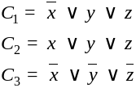
Subset Sum
Construction. Given 3-SAT instance Φ with n variables and k clauses, form 2n + 2k decimal integers, each of n+k digits, as illustrated below.
Claim. Φ is satisfiable iff there exists a subset that sums to W.
Pf. No carries possible.
x
y
z
C₁
C₂
C₃
x
1
0
0
0
1
0
100,110
¬ x
1
0
0
1
0
1
100,001
y
0
1
0
1
0
0
10,000
¬ y
0
1
0
0
1
1
10,111
z
0
0
1
1
1
0
1,010
¬ z
0
0
1
0
0
1
1,101
0
0
0
1
0
0
100
0
0
0
2
0
0
200
dummies to get
clause columns
to sum to 4
0
0
0
0
1
0
10
0
0
0
0
2
0
20
0
0
0
0
0
1
1
0
0
0
0
0
2
2
W
1
1
1
4
4
4
111,444
Notes:
Note: this proof is substantially different from the one in the book - the main advantage is that it does not rely on 3DM. (Also works with fixed base, e.g., 10.)
See Extra Slides for the proof from the book.

Slide 38
Scheduling With Release Times
SCHEDULE-RELEASE-TIMES. Given a set of n jobs with processing time t_{i}, release time r_{i}, and deadline d_{i}, is it possible to schedule all jobs on a single machine such that job i is processed with a contiguous slot of t_{i} time units in the interval [r_{i}, d_{i} ] ?
Claim. SUBSET-SUM ≤ _{P} SCHEDULE-RELEASE-TIMES.
Pf. Given an instance of SUBSET-SUM w₁, …, w_{n}, and target W,
  Create n jobs with processing time t_{i} = w_{i}, release time r_{i} = 0, and no deadline (d_{i} = 1 + Σ_{j} w_{j}).
  Create job 0 with t₀ = 1, release time r₀ = W, and deadline d₀ = W+1.
Can schedule jobs 1 to n anywhere but [W, W+1]
job 0
0
W
W+1
S+1

Slide 39
8.10 A Partial Taxonomy of Hard Problems

Slide 40
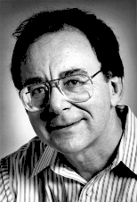
Polynomial-Time Reductions
constraint satisfaction
3-SAT
Dick Karp (1972)
1985 Turing Award
3-SAT reduces to INDEPENDENT SET
INDEPENDENT SET
DIR-HAM-CYCLE
GRAPH 3-COLOR
SUBSET-SUM
VERTEX COVER
HAM-CYCLE
PLANAR 3-COLOR
SCHEDULING
SET COVER
TSP
packing and covering
sequencing
partitioning
numerical
Notes:
Karp analyzed most juicy open problem in discrete math – showed most were NP-complete
x -> y means x reduces to y (if you can solve y, then you can solve x)
Then to join the NP complete club, you need a reduction from SAT (or any other current member) to you

Slide 41
Extra Slides

Slide 42
Subset Sum (proof from book)
Construction. Let X ∪ Y ∪ Z be a instance of 3D-MATCHING with triplet set T. Let n = |X| = |Y| = |Z| and m = |T|.
  Let X = { x₁, x₂, x₃ x₄ }, Y = { y₁, y₂, y₃, y₄ } , Z = { z₁, z₂, z₃, z₄ }
  For each triplet t= (x_{i}, y_{j}, z_{k} ) ∈ T, create an integer w_{t} with 3n digits that has a 1 in positions i, n+j, and 2n+k.
Claim. 3D-matching iff some subset sums to W = 111,…, 111.
use base m+1
Triplet t_{i}
x₁
x₂
x₃
x₄
y₁
y₂
y₃
y₄
z₁
z₂
z₃
z₄
w_{i}
x₁
y₂
z₃
1
0
0
0
0
1
0
0
0
0
1
0
100,001,000,010
x₂
y₄
z₂
0
1
0
0
0
0
0
1
0
1
0
0
10,000,010,100
x₁
y₁
z₁
1
0
0
0
1
0
0
0
1
0
0
0
100,010,001,000
x₂
y₂
z₄
0
1
0
0
0
1
0
0
0
0
0
1
10,001,000,001
x₄
y₃
z₄
0
0
0
1
0
0
1
0
0
0
0
1
100,100,001
x₃
y₁
z₂
0
0
1
0
1
0
0
0
0
1
0
0
1,010,000,100
x₃
y₁
z₃
0
0
1
0
1
0
0
0
0
0
1
0
1,010,000,010
x₃
y₁
z₁
0
0
1
0
1
0
0
0
1
0
0
0
1,010,001,000
x₄
y₄
z₄
0
0
0
1
0
0
0
1
0
0
0
1
100,010,001
111,111,111,111

Slide 43
Partition
SUBSET-SUM. Given natural numbers w₁, …, w_{n} and an integer W, is there a subset that adds up to exactly W?
PARTITION. Given natural numbers v₁, …, v_{m} , can they be partitioned into two subsets that add up to the same value?
Claim. SUBSET-SUM ≤ _{P} PARTITION.
Pf. Let W, w₁, …, w_{n} be an instance of SUBSET-SUM.
  Create instance of PARTITION with m = n+2 elements.
    v₁ = w₁, v₂ = w₂, …, v_{n} = w_{n}, v_{n+1} = 2 Σ_{i} w_{i} - W, v_{n+2} = Σ_{i} w_{i} + W
  There exists a subset that sums to W iff there exists a partition since two new elements cannot be in the same partition. ▪
½ Σ_{i} v_{i}
v_{n+1} = 2 Σ_{i} w_{i} - W
W
subset A
v_{n+2} = Σ_{i} w_{i} + W
Σ_{i} w_{i} - W
subset B

Slide 44
Extra Slides: 4 Color Theorem

Slide 45
Planar 3-Colorability
PLANAR-3-COLOR. Given a planar map, can it be colored using 3 colors so that no adjacent regions have the same color?
YES instance.
Notes:
applications to DNA
multi-million dollar industrial applications

Slide 46
Planar 3-Colorability
PLANAR-3-COLOR. Given a planar map, can it be colored using 3 colors so that no adjacent regions have the same color?
NO instance.

Slide 47
Planarity
Def. A graph is planar if it can be embedded in the plane in such a way that no two edges cross.
Applications: VLSI circuit design, computer graphics.
Kuratowski's Theorem. An undirected graph G is non-planar iff it contains a subgraph homeomorphic to K₅ or K_{3,3}.
Planar
K₅: non-planar
K_{3,3}: non-planar
homeomorphic to K_{3,3}

Slide 48
Planarity Testing
Planarity testing. [Hopcroft-Tarjan 1974] O(n).
Remark. Many intractable graph problems can be solved in poly-time if the graph is planar; many tractable graph problems can be solved faster if the graph is planar.
simple planar graph can have at most 3n edges

Slide 49
Planar 3-Colorability
Claim. 3-COLOR ≤ _{P} PLANAR-3-COLOR.
Proof sketch: Given instance of 3-COLOR, draw graph in plane, letting edges cross if necessary.
  Replace each edge crossing with the following planar gadget W.
    in any 3-coloring of W, opposite corners have the same color
    any assignment of colors to the corners in which opposite corners have the same color extends to a 3-coloring of W

Slide 50
Planar k-Colorability
PLANAR-2-COLOR. Solvable in linear time.
PLANAR-3-COLOR. NP-complete.
PLANAR-4-COLOR. Solvable in O(1) time.
Theorem. [Appel-Haken, 1976] Every planar map is 4-colorable.
  Resolved century-old open problem.
  Used 50 days of computer time to deal with many special cases.
  First major theorem to be proved using computer.
False intuition. If PLANAR-3-COLOR is hard, then so is PLANAR-4-COLOR and PLANAR-5-COLOR.
Notes:
4 color theorem
-------------------
* resolved 100+ year old open problem
* used 1200+ hours of computer time to deal with many
special cases and configurations
* first major theorem to be proved using computer

Slide 51
Polynomial-Time Detour
Graph minor theorem. [Robertson-Seymour 1980s]
Corollary. There exist an O(n³) algorithm to determine if a graph can be embedded in the torus in such a way that no two edges cross.
Pf of theorem. Tour de force.
Notes:
Juvan-Mohar 2005 = LEDA implementation
Juvan-Marincek-Mohar = linear time, but constant is still enormous

Slide 52
Polynomial-Time Detour
Graph minor theorem. [Robertson-Seymour 1980s]
Corollary. There exist an O(n³) algorithm to determine if a graph can be embedded in the torus in such a way that no two edges cross.
Mind boggling fact 1. The proof is highly non-constructive!
Mind boggling fact 2. The constant of proportionality is enormous!
Theorem. There exists an explicit O(n) algorithm.
Practice. LEDA implementation guarantees O(n³).
Unfortunately, for any instance G = (V, E) that one could fit into the known universe, one would easily prefer n⁷⁰ to even constant time, if that constant had to be one of Robertson and Seymour's. - David Johnson
Notes:
"The computation of the constant takes 9 steps, but most of the damage is concentrated in just three of them. Each is an application of some variant on the
"towers of 2s" generator t(k) where t(k) = 2^2^2^…2 [k times]. The first application computes a value θ₁ that is at least t(n/2). The second yields θ₂ which is
θ₁ tall. The third application yields a tower which is something like triply exponential in θ₂ . Still primitive recursive and slower than Ackermann's function."
Johnson, NP-Completeness Column #19

